Slide 1
Encapsulation & composition
Dominik Gajewski

Slide 2
Object-oriented programming
Fundamental concepts and features
  Inheritance
  Abstraction
  Encapsulation
  (Subtype) polymorphism

Slide 3
encapsulation

Slide 4
encapsulation
Encapsulation is a mechanism used to hide the:
  Data
  Internal structure
  Implementation details of objects
All interaction with the object is through a
public interface of operations
Classes should not expose their internal implementation details

Slide 5
Encapsulation – how it’s work
You should use private members and appropriate assessors and mutators wherever is possible.

Slide 6
Encapsulation – how it’s work
public class Student {
private String name;
public String getName(){
return name;
}
public void setName(String newName){
name = newName;
}
}

Slide 7
Encapsulation – how it’s work
You can put constraints on values
public void setName(String newName){
if(newName == null){
//error
}
name = newName;
}
If users of your class accessed the fields directly, then they would each be responsible for checking constraints

Slide 8
Next example
private double speed;
public double getSpeed() {
return(speed);
}
public void setSpeed(double newSpeed){
if (newSpeed < 0) {
sendErrorMessage(...);
newSpeed = Math.abs(newSpeed);
}
speed = newSpeed;
}

Slide 9
Encapsulation – how it’s work
You can change your internal representation without changing the interface
public void setSpeedInMPH(double newSpeed){
speedInKPH = convert(newSpeed);
}
public void setSpeedInKPH(double newSpeed){
speedInKPH = newSpeed;
}

Slide 10
Encapsulation – how it’s work
You can perform arbitrary side effects
public double setSpeed(double newSpeed){
speed = newSpeed;
notifyObservers();
}
If users of your class accessed the fields directly, then they would each be responsible for executing side effects

Slide 11
composition

Slide 12
composition
Method of reuse in which new functionality is obtained by creating an object composed of other objects
The new functionality is obtained by delegating functionality to one of the objects being composed
Sometimes called aggregation or containment, although some authors give special meanings to these terms

Slide 13
Composition - For example:
Aggregation - when one object owns or is responsible for another object and both objects have identical lifetimes (GoF)
Aggregation - when one object has a collection of objects that can exist on their own (UML)
Containment - a special kind of composition in which the contained object is hidden from other objects and access to the contained object is only via the container object (Coad)

Slide 14
Composition
Composition can be:
  By reference
  By value
C++ allows composition by value or by reference
But in Java all we have are object references!

Slide 15
Advantages of composition
Contained objects are accessed by the containing class solely through their interfaces
"Black-box" reuse, since internal details of contained objects are not visible
Good encapsulation
Fewer implementation dependencies
Each class is focused on just one task
The composition can be defined dynamically at run-time through objects acquiring references to other objects of the same type

Slide 16
disAdvantages of composition
Resulting systems tend to have more objects
Interfaces must be carefully defined in order to use many different objects as composition blocks

Slide 17
Inheritance
Method of reuse in which new functionality is obtained by extending the implementation of an existing object
The generalization class (the superclass) explicitly captures the common attributes and methods
The specialization class (the subclass) extends the implementation with additional attributes and methods

Slide 18
Advantages of Inheritance
New implementation is easy, since most of it is inherited
Easy to modify or extend the implementation being reused

Slide 19
disAdvantages of Inheritance
Breaks encapsulation, since it exposes a subclass to implementation details of its superclass
"White-box" reuse, since internal details of superclasses are often visible to subclasses
Subclasses may have to be changed if the implementation of the superclass changes
Implementations inherited from superclasses can not be changed at run-time

Slide 20
Some code - Inheritance
public class Employee {
public String name;
public String surname;
public Employee(String name, String surname) {
this.name = name;
this.surname = surname;
}
public class Manager extends Employee{
public String phoneNo;
public Manager(String name, String surname) { super(name, surname); }
}

Slide 21
Coad's Rules
Use inheritance only when all of the following criteria are satisfied:
A subclass expresses "is a special kind of" and not "is a role played by a"
An instance of a subclass never needs to become an object of another class
A subclass extends, rather than overrides or nullifies, the responsibilities of its superclass
A subclass does not extend the capabilities of what is merely a utility class
For a class in the actual Problem Domain, the subclass specializes a role, transaction or device

Slide 22
Vehicle
Motor vehicle
Motorcycle
Car
Bicycle
Wagon
Engine
Electric
Disel

Slide 23
Inheritance
  Motor vehicle is a special kind of Vehicle
  Motorcycle is a special kind of Motor vehicle
  Etc…
Composition
  Engine is a role played by a Motor vehicle
  Or
  Motor vehicle inculde Engine

Slide 24
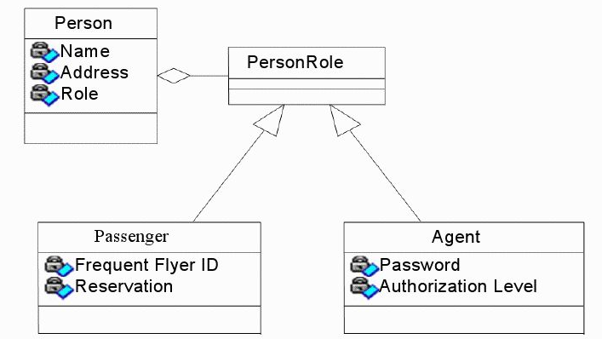

Slide 25
Inheritance/Composition Summary
Both composition and inheritance are important methods of reuse
Inheritance was overused in the early days of OO development
Over time we've learned that designs can be made more reusable and simpler by favoring composition
Of course, the available set of composable classes can be enlarged using inheritance
So composition and inheritance work together

Slide 26
Thank you for your attention

